Slide 1
Algorithm Analysis
Insertion Sort

Slide 2
Sorting
Arrange an unordered list of elements in some order.
Some common algorithms
Bubble Sort
Insertion Sort
Merge Sort
Quick Sort

Slide 3
Sorting
Important primitive
For today, we’ll pretend all elements are distinct.
6
4
3
8
1
5
2
7
1
2
3
4
5
6
7
8
Length of the list is n

Slide 4
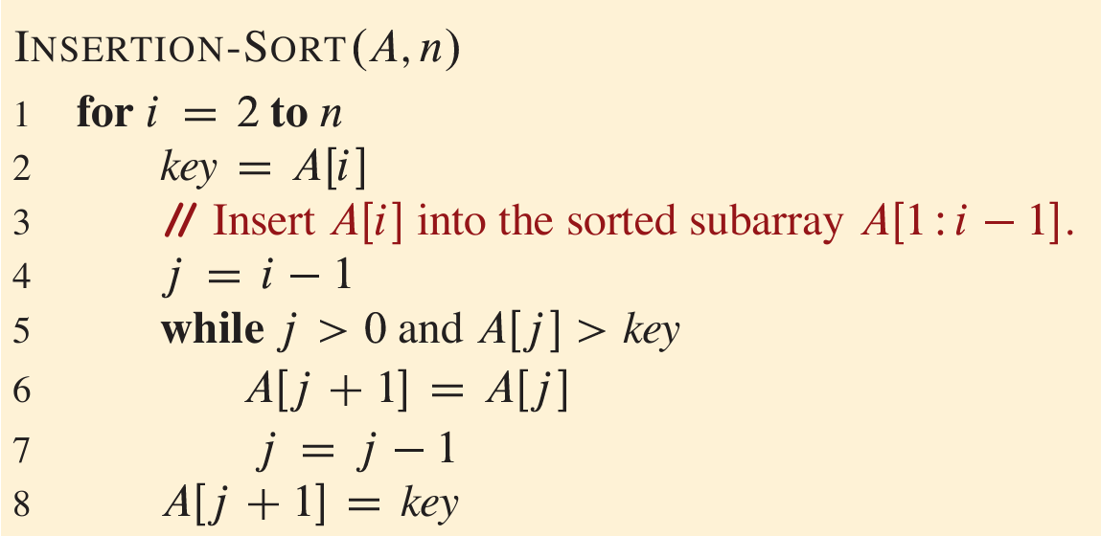
Insertion Sort

Slide 5
Insertion Sort example
6
4
3
8
5
Start by moving A[1] toward the beginning of the list until you find something smaller (or can’t go any further):
Insertion-Sort(A, n)
for i = 1 to n – 1
key = A[i]
j = i – 1
while j >= 0 and A[j] > key
A[j + 1] = A[j]
j = j – 1
A[j + 1] = key
6
4
3
8
5
4
6
3
8
5

Slide 6
Insertion Sort example
6
4
3
8
5
Insertion-Sort(A, n)
for i = 1 to n – 1
key = A[i]
j = i – 1
while j >= 0 and A[j] > key
A[j + 1] = A[j]
j = j – 1
A[j + 1] = key
Then move A[2]:
key = 3
4
6
3
8
5
4
6
6
8
5
4
4
6
8
5
3
4
6
8
5

Slide 7
Insertion Sort example
6
4
3
8
5
Insertion-Sort(A, n)
for i = 1 to n – 1
key = A[i]
j = i – 1
while j >= 0 and A[j] > key
A[j + 1] = A[j]
j = j – 1
A[j + 1] = key
Then move A[3]:
key = 8
3
4
6
8
5
3
4
6
8
5

Slide 8
Insertion Sort example
6
4
3
8
5
Insertion-Sort(A, n)
for i = 1 to n – 1
key = A[i]
j = i – 1
while j >= 0 and A[j] > key
A[j + 1] = A[j]
j = j – 1
A[j + 1] = key
Then move A[4]:
key = 5
3
4
6
8
5
3
4
6
8
8
3
4
6
6
8
3
4
5
6
8

Slide 9
Insertion Sort example
6
4
3
8
5
Start by moving A[1] toward the beginning of the list until you find something smaller (or can’t go any further):
Then move A[3]:
6
4
3
8
5
3
4
6
8
5
4
6
3
8
5
3
4
6
8
5
Then move A[2]:
Then move A[4]:
4
6
3
8
5
3
4
6
8
5
3
4
6
8
5
3
4
5
6
8
Then we are done!

Slide 10
Why does this work?
Say you have a sorted list, , and another element .
Insert right after the largest thing that’s still smaller than . (Aka, right after ).
Then you get a sorted list:
3
4
6
8
5
5
5
4
3
4
5
6
8

Slide 11
This sounds like a job for…
Proof By Induction!

Slide 12
Outline of a proof by induction
Let A be a list of length n
Base case:
A[:1] is sorted at the end of the 0’th iteration. ✓
Inductive Hypothesis:
A[:i+1] is sorted at the end of the i^{th} iteration (of the outer loop).
Inductive step:
For any 0 < k < n, if the inductive hypothesis holds for i=k-1, then it holds for i=k.
Aka, if A[:k] is sorted at step k-1, then A[:k+1] is sorted at step k (previous slide)
Conclusion:
The inductive hypothesis holds for i = 0, 1, …, n-1.
In particular, it holds for i=n-1.
At the end of the n-1’st iteration (aka, at the end of the algorithm), A[:n] = A is sorted.
That’s what we wanted! ✓

Slide 13
Algorithm Analysis
Estimate the resources required by an algorithm
Memory
Communication Bandwidth
Energy Consumption
Computational Time
Helps identify the most efficient one

Slide 14
Algorithm Analysis (Insertion Sort)
Timing the run of insertion sort on our computer
We will get runtime estimates for,
A particular computer
A particular input
A particular implementation
A particular compiler/interpreter
Particular libraries and background tasks
What about others?

Slide 15
Algorithm Analysis
Assumptions
One-processor
Random-access machine (RAM) model of computation

Slide 16
Random-access Machine
Random-access machine (RAM)
Instructions execute one after another
No concurrent operations
Each instructions takes the same amount of time
Each data access takes the same amount of time
Contains commonly found instructions
Arithmetic (add subtract, multiply, divide, remainder, floor, ceiling)
Data movement (load, store, copy) and
Control (branching, call and return)
Includes common data types
Doesn’t model memory hierarchy

Slide 17
Algorithm Analysis (Insertion Sort)
Runtime depends on inputs
Sort an array of 10000 items vs Sort and array of 3 items
Input Size
Problem specific
For sorting, the number of items in the input
For multiplication, the total number of bits needed for representation
For graph, the number of nodes and edges

Slide 18
Algorithm Analysis (Insertion Sort)
Running time of an algorithm
For a given input
The number of instructions and data access executed
Assumption
Constant time taken by each line of the pseudocode

Slide 19
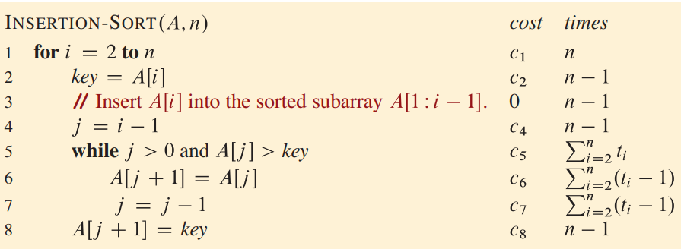
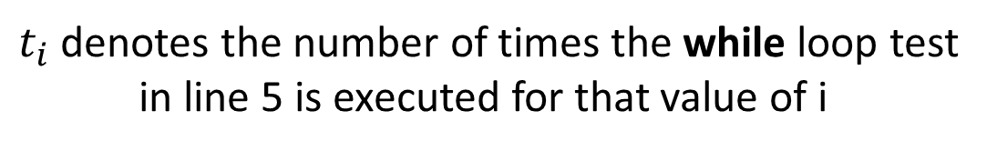
Algorithm Analysis (Insertion Sort)
$t_{i}$ denotes the number of times the while loop test
in line 5 is executed for that value of i

Slide 20
Algorithm Analysis (Insertion Sort)
T(n) denote the running time of an algorithm on an input of size of n

Slide 21
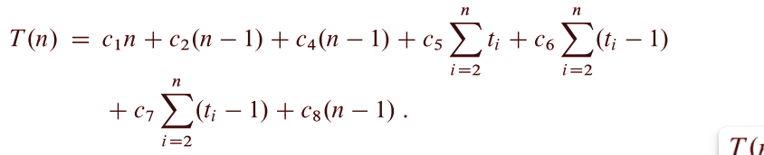
Algorithm Analysis (Insertion Sort)

Slide 22


Algorithm Analysis (Insertion Sort)
Best Case
The array is sorted
$t_{i}=1$ for all $i=2, 3, …, n$

Slide 23

Algorithm Analysis (Insertion Sort)
Best Case
The array is sorted
$t_{i}=1$ for all $i=2, 3, …, n$
$$T\left(n\right)=an+b$$
where $a=c_{1}+c_{2}+c_{4}+c_{5}+c_{8}$
and $b={−(c}_{2}+c_{4}+c_{5}+c_{8})$
A linear function of n

Slide 24
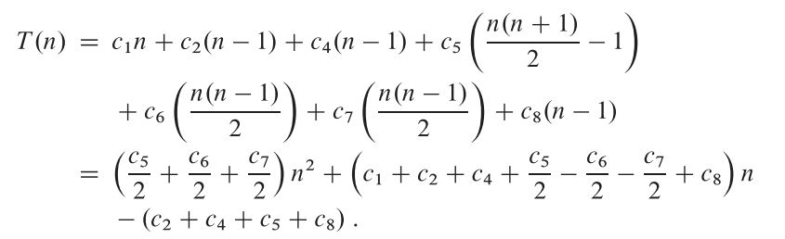

Algorithm Analysis (Insertion Sort)
Worst Case
The array is sorted in reverse order
$t_{i}=i$ for all $i=2, 3, …, n$

Slide 25

Algorithm Analysis (Insertion Sort)
Best Case
The array is sorted
$t_{i}=i$ for all $i=2, 3, …, n$
$$T\left(n\right)=an^{2}+bn+c$$
where $a, b$ and $c$ are constants
A quadratic function of n

Slide 26
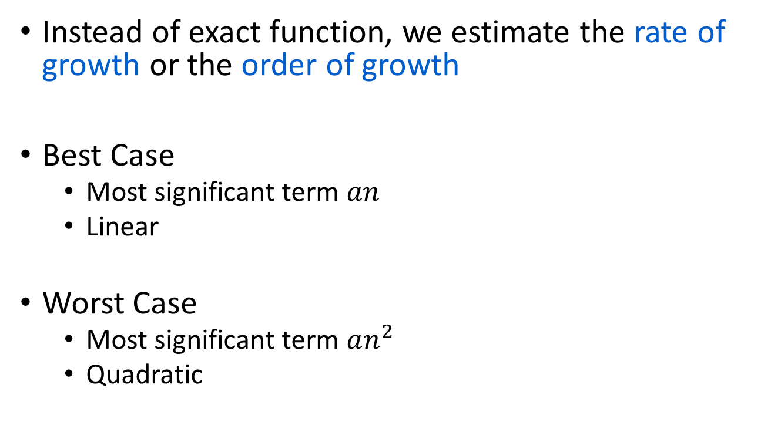
Algorithm Analysis (Insertion Sort)
Instead of exact function, we estimate the rate of growth or the order of growth
Best Case
Most significant term $an$
Linear
Worst Case
Most significant term $an^{2}$
Quadratic

Slide 27
Reference
CLRS Chapter 2
Sections 2.1, 2.2

